Slide 1
I/O OPERATIONS IN JAVASCRIPT
Sai Vardhan T

Slide 2
INPUT METHODS IN JS
PROMPT()
CONFIRM()

Slide 3
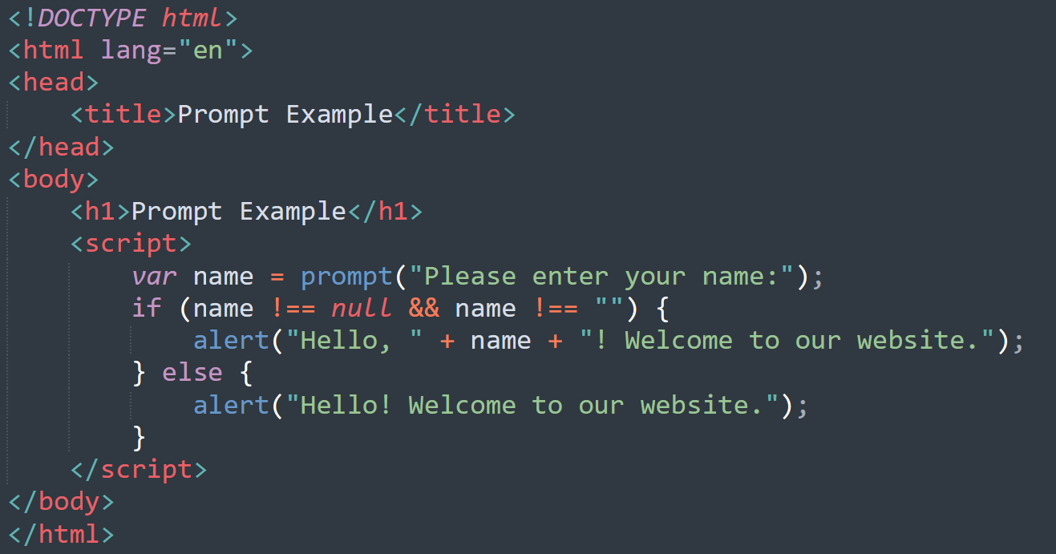
PROMPT
Displays a dialog box with a message prompting the user to input text. Returns the text entered by the user.

Slide 4
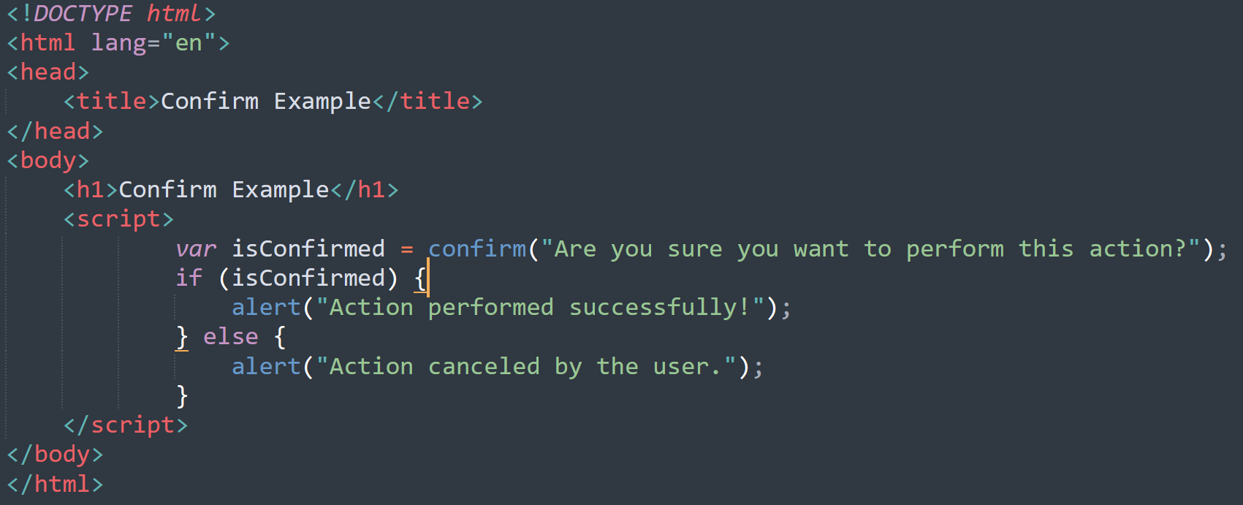
CONFIRM
Displays a dialog box with a message and OK/Cancel buttons. Returns true if the user clicks OK, and false if they click Cancel.

Slide 5
OUTPUT METHODS
CONSOLE.LOG()
DOCUMENT WRITE
INNER HTML
CONSOLE WARNING
ALERT
CONSOLE ERROR

Slide 6
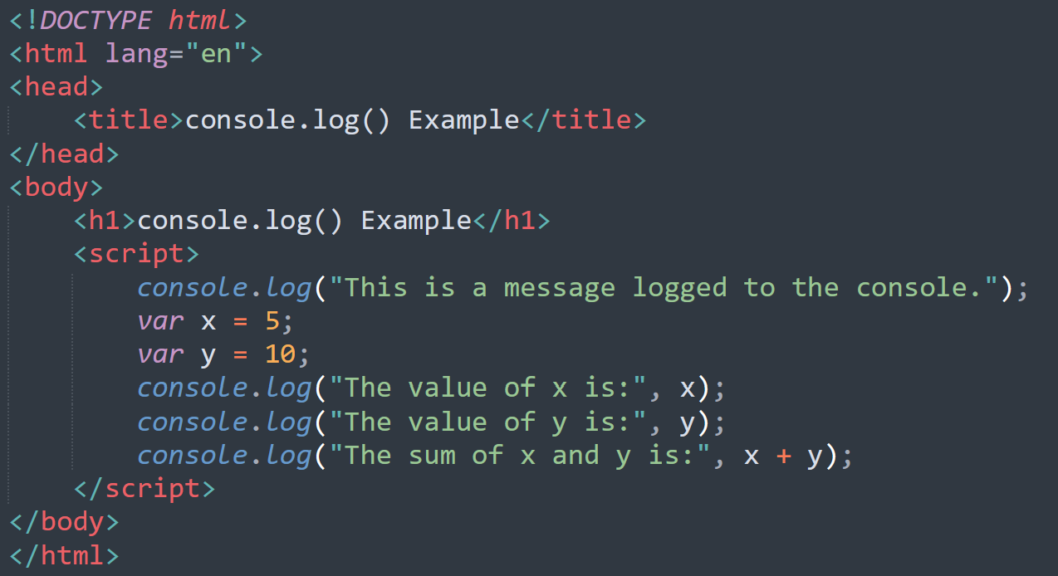
CONSOLE LOG
Outputs a message to the browser console. It's primarily used for debugging purposes.

Slide 7
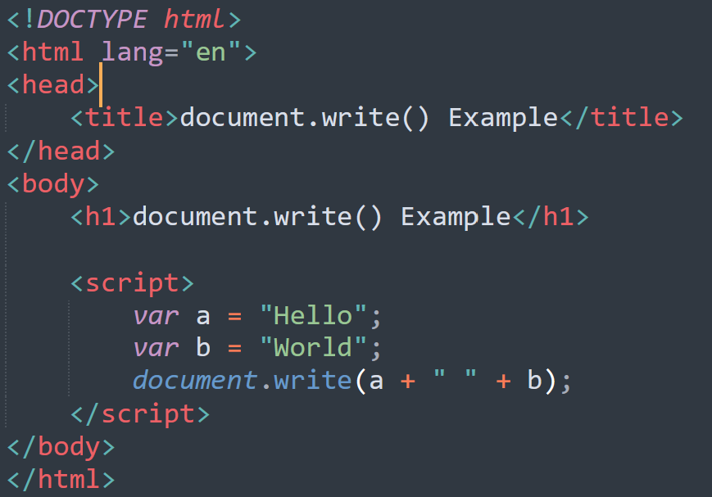
DOCUMENT WRITE
Writes HTML content directly to the document. It will add the data based on the flow of content in HTML document.

Slide 8
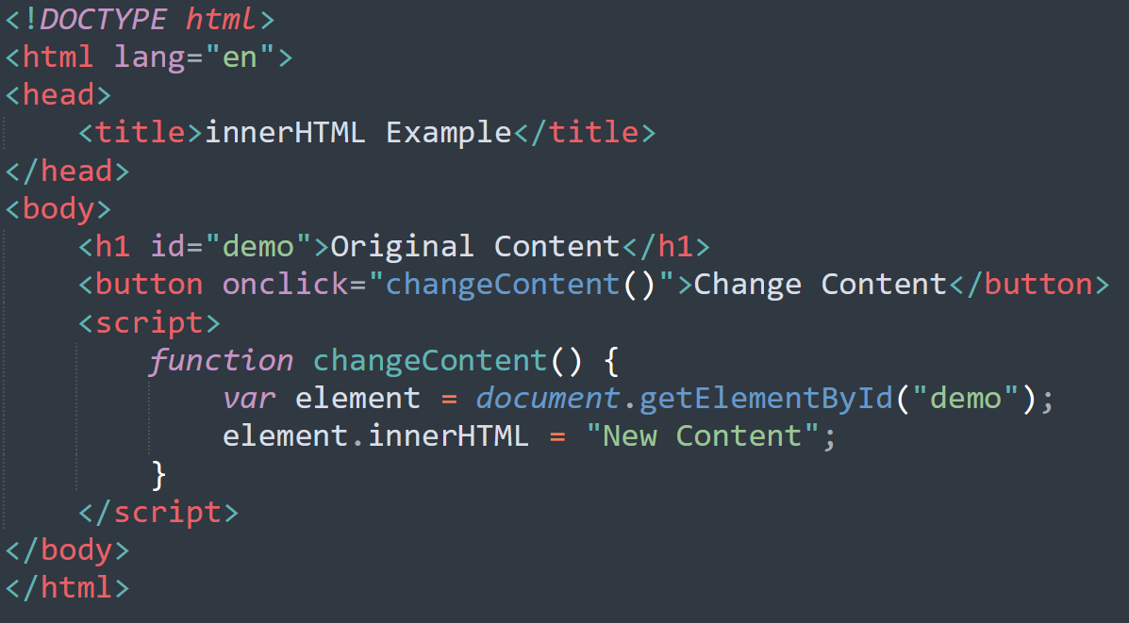
INNER HTML
Manipulating the innerHTML property of an HTML element allows you to dynamically update its content.

Slide 9
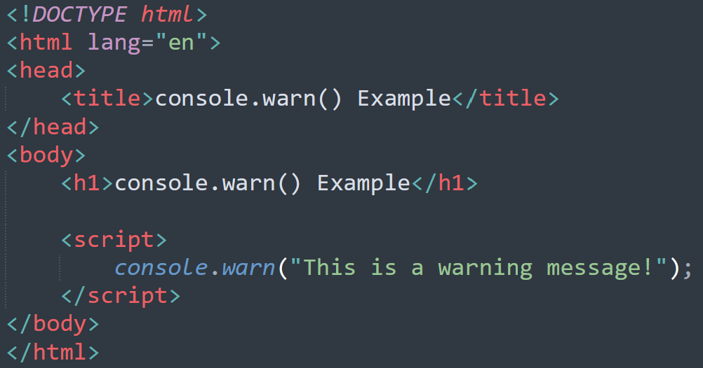
CONSOLE WARNING
Outputs a warning message to the browser console. It's used to log warnings and potential issues.

Slide 10
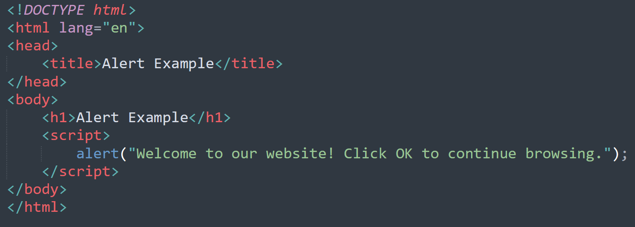
ALERT
Displays a dialog box with a message and an OK button. It's used to display information to the user.

Slide 11
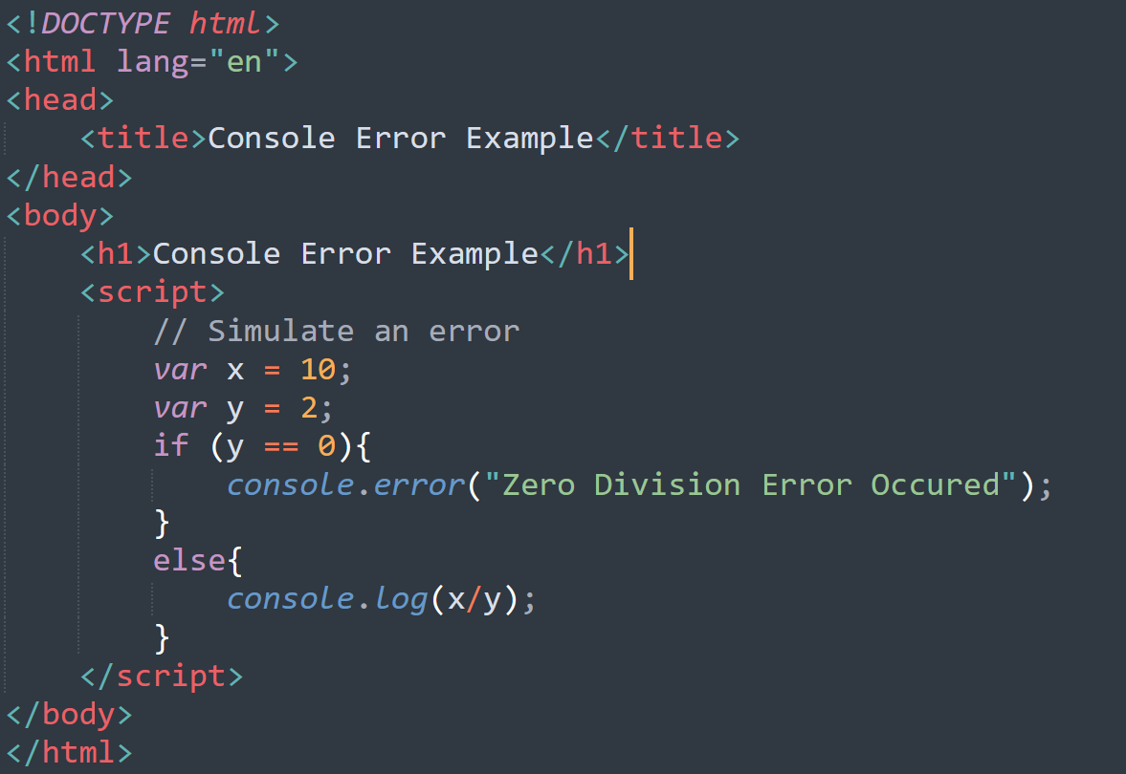
CONSOLE ERROR
Outputs an error message to the browser console. It's used to log errors and issues.

